Slide 1
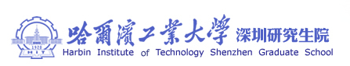
Motion Control：Lecture 4.2
Curve Interpolation to Point Data
Jiangang Li
Nov 14 2016

Slide 2
Globe( It is smooth)
Up Limited
Real tool path express by lines
Ideal tool path
Down Limited
b) Local ( It is smooth too.)
Fig.1 Tool Path in Globe and Local

Slide 3


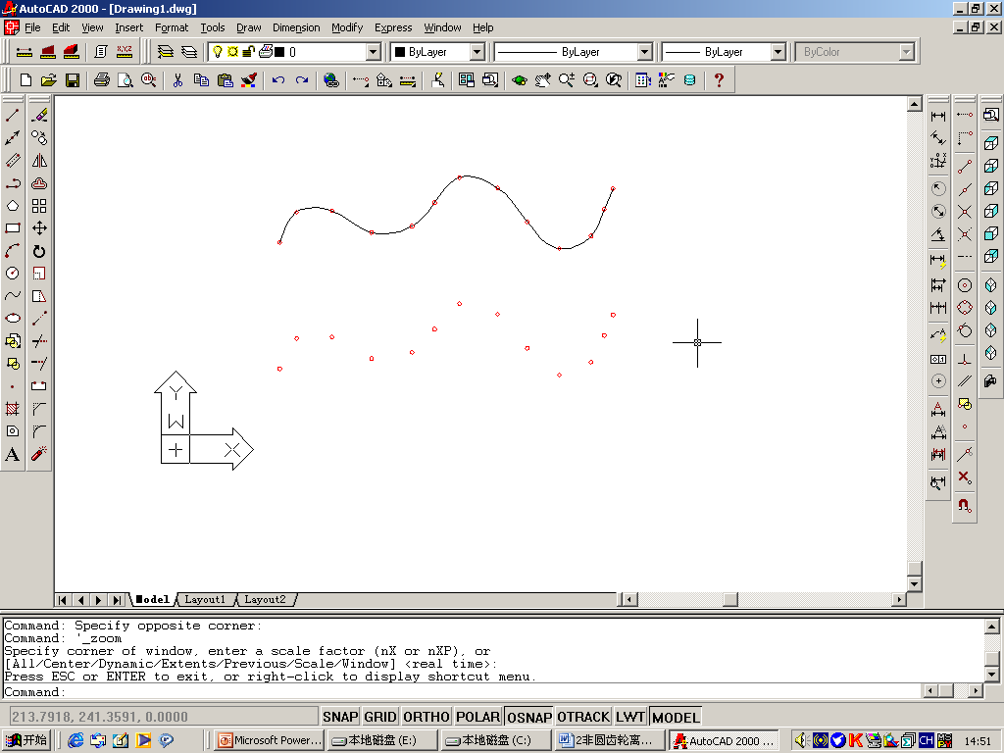
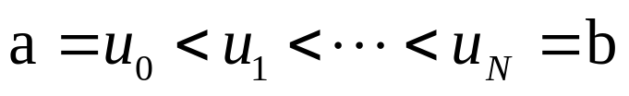





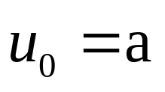

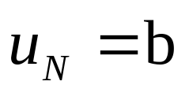
Piecewise Cubic Spline(PCS)
Definition:
Piecewise Cubic Spline (PCS) — Interpolate the given set of data points and have smooth continuity up to the second derivative.
Where
Fig. 1 Piecewise Cubic Spline

Slide 4


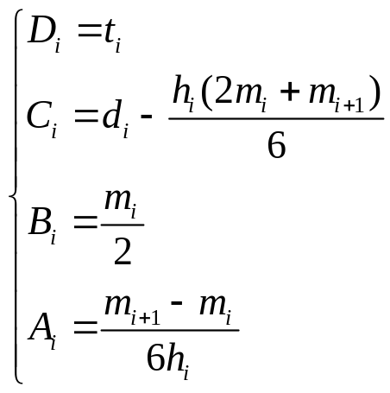

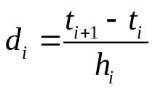





Piecewise Cubic Spline(PCS)
The expression of PCS:
where
，
，
where
，
；
，
；
，
；
，
；

Slide 5
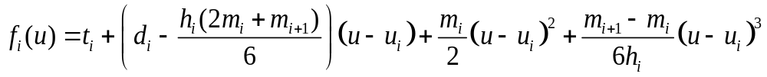
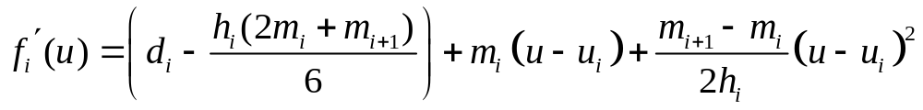
Piecewise Cubic Spline(PCS)
（3.1-4）
Where,
,
.
（3.1-5）
Where,
,
.

Slide 6

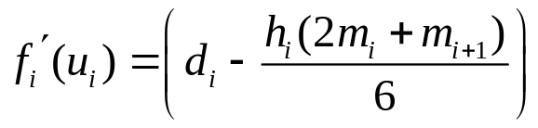
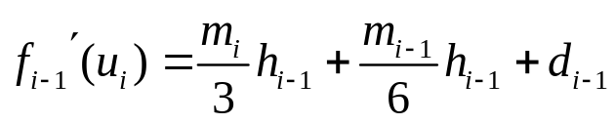






Piecewise Cubic Spline(PCS)
The first order differential of point.
（3.1-6）
（3.1-7）
For,
（3.1-8）
We can get:
（3.1-9）
System is an underdetermined system of linear equations involving unknown parameters

Slide 7
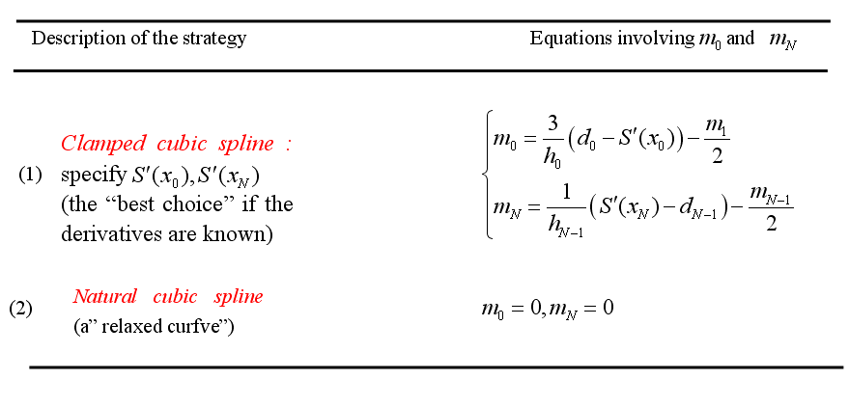
Piecewise Cubic Spline(PCS)
End point constraints for a cubic spline
3

Slide 8
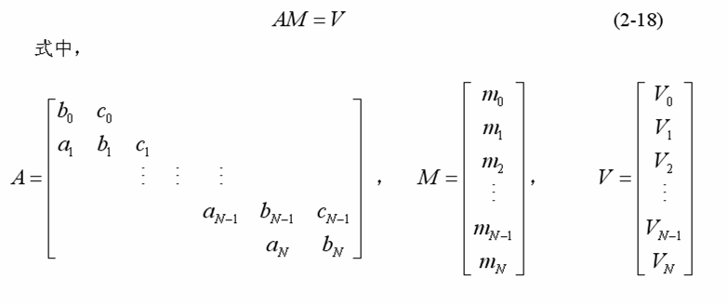
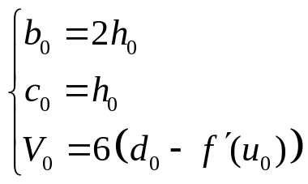
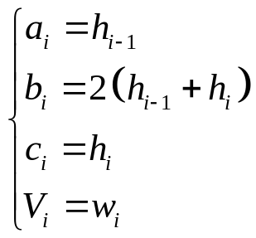

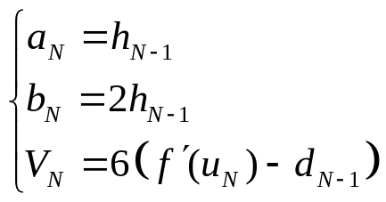

Piecewise Cubic Spline(PCS)
For clamped cubic spline:
（3.1-10）
where
Where,
For , ;
For , ;
For , ;

Slide 9

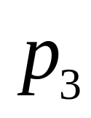
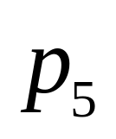
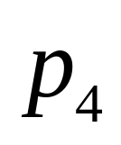
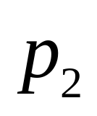
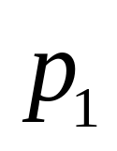
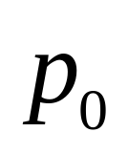
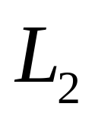
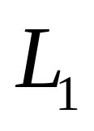
Piecewise Cubic Spline(PCS)
2 Interpolation CL Path by CPCS
Continuous line segments

Slide 10



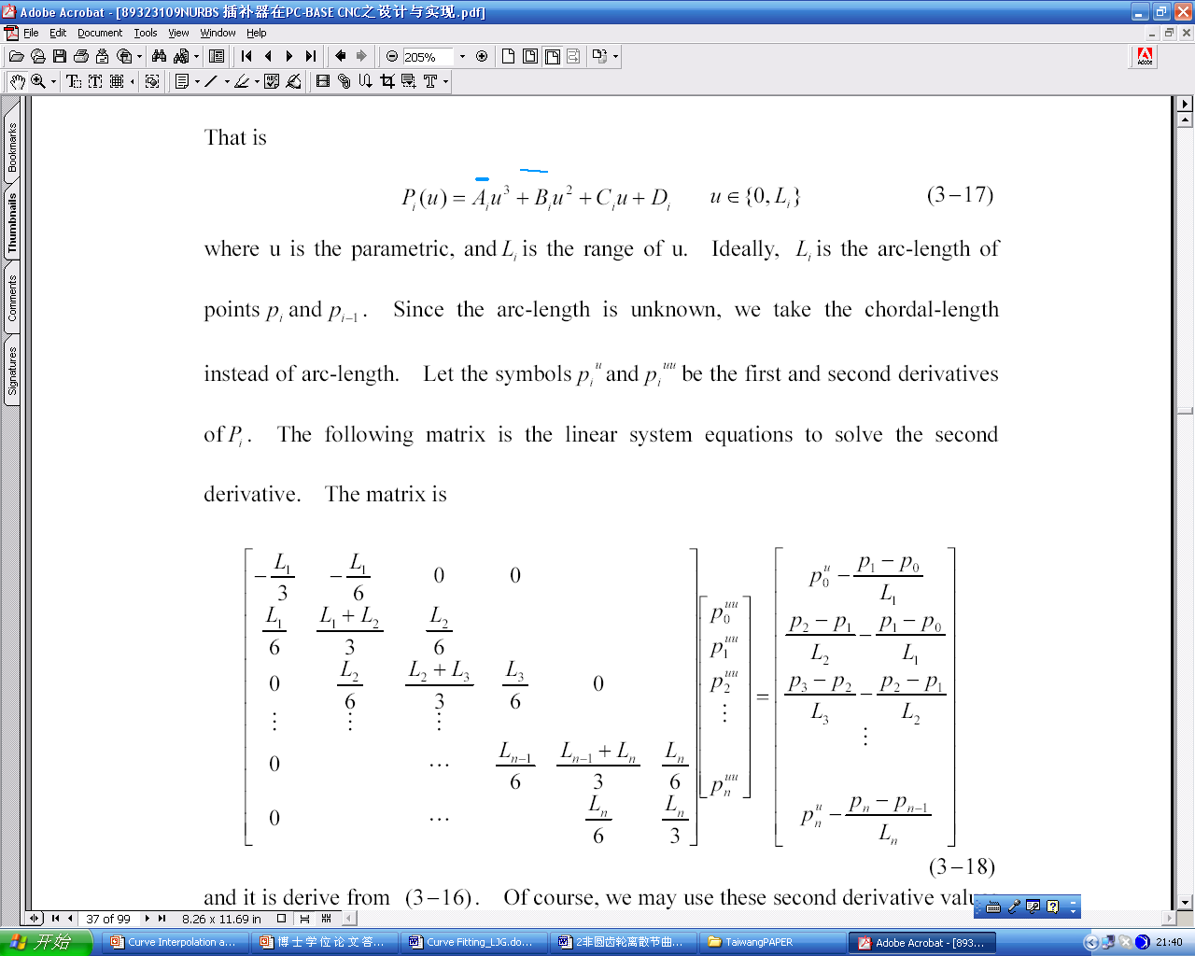
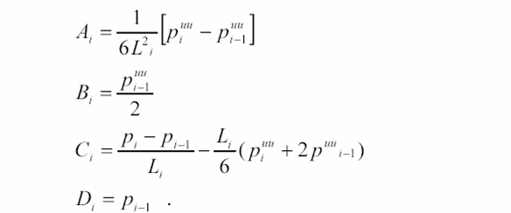
Piecewise Cubic Spline(PCS)
a. Chord-Length Parameterized
b. Interpolation respectively by CPCS
Where,

Slide 11
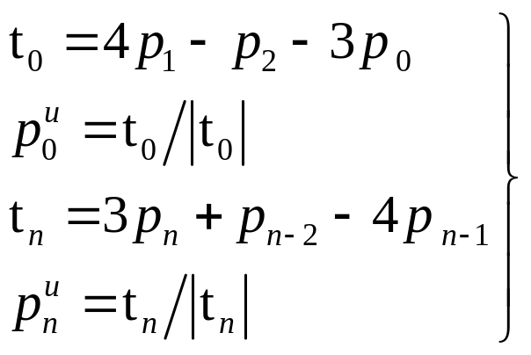
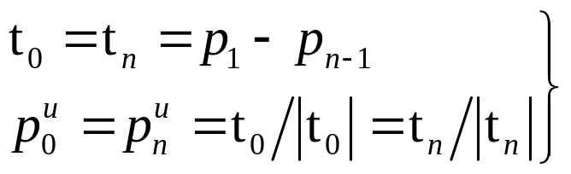
Piecewise Cubic Spline(PCS)
c. Endpoint constraint for a CPCS
There are two strategies:
1 If the cubic spline is an open curve
2 If the cubic spline is a close curve

Slide 12

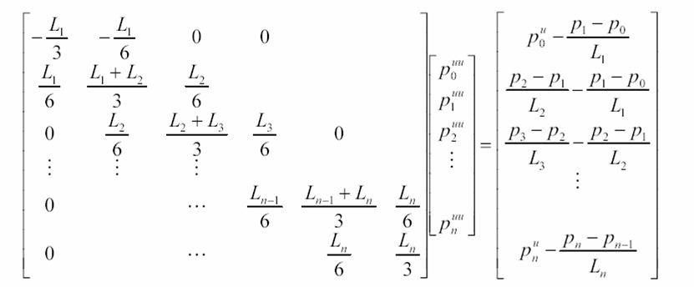
Piecewise Cubic Spline(PCS)
The equations involving by matrix type

Slide 13





Piecewise Cubic Spline(PCS)
Cubic Spline Curve
Cubic Spline Curve Interpolating

Slide 14
Nearly Unit Parameterized Cubic Splines (NUPCS)
Interpolate respectively by Nearly Unit Parameterized Cubic Splines (NUPCS)

Slide 15
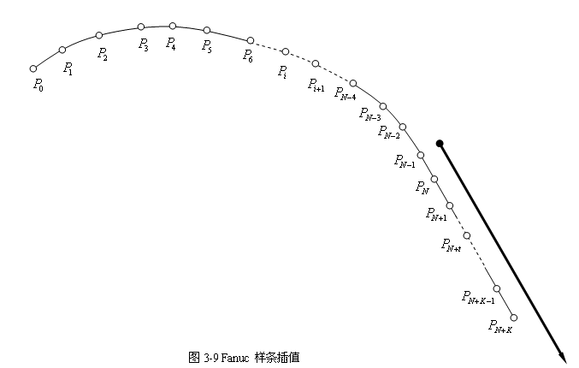
Nearly Unit Parameterized Cubic Splines (NUPCS)
NUPCS

Slide 16


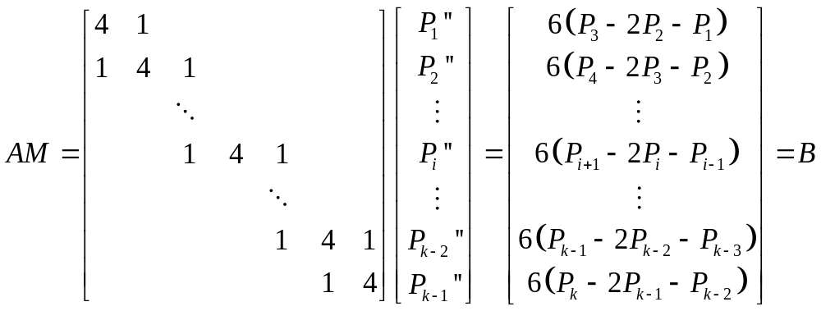
Nearly Unit Parameterized Cubic Splines (NUPCS)
For natural cubic spline, , we can get

Slide 17


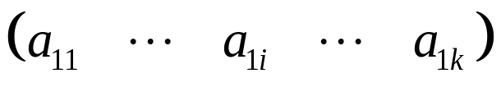
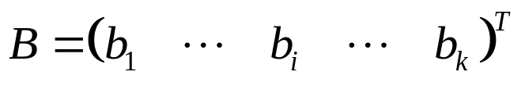
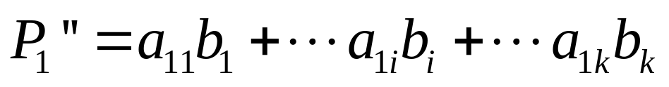
Nearly Unit Parameterized Cubic Splines (NUPCS)
The first row of can be expressed as
So,
Data of the first row of
0.26795 -0.071797 0.019238 -0.0051548 0.0013812 -0.0003701 9.9167e-005 -2.6572e-005 …..

Slide 18


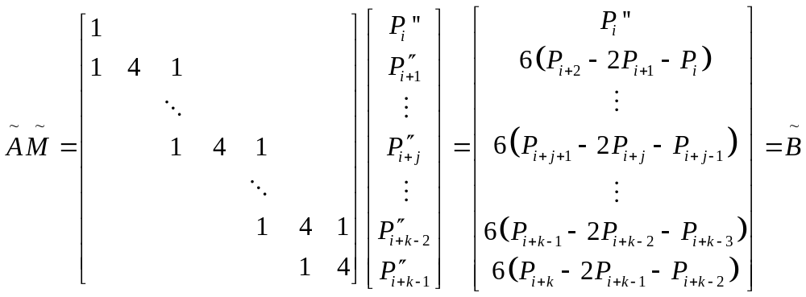
Nearly Unit Parameterized Cubic Splines (NUPCS)
At the condition that the second derivative is known and , the following linear equation can be deduced.

Slide 19

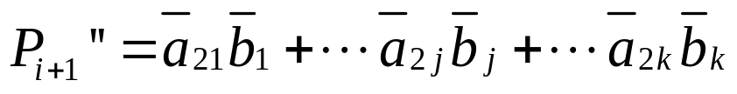
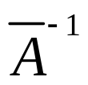
Nearly Unit Parameterized Cubic Splines (NUPCS)
We can get:
Data of the second row of
-0.26795 0.26795 -0.071797 0.019238 -0.0051548 0.0013812 -0.0003701 9.9167e-005……

Slide 20
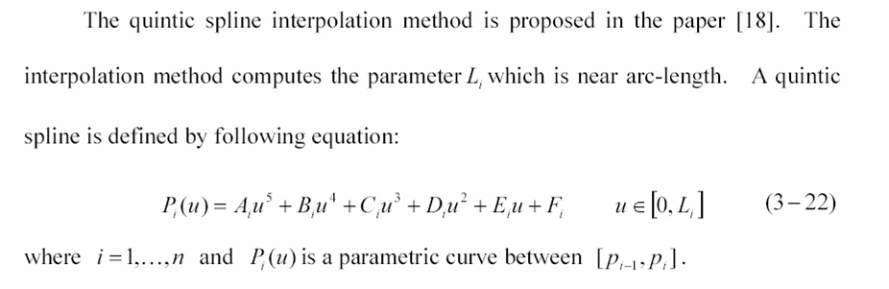
Nearly Arc-Length Parameterized Quintic Splines (NAPQS)
（3.3-1）

Slide 21
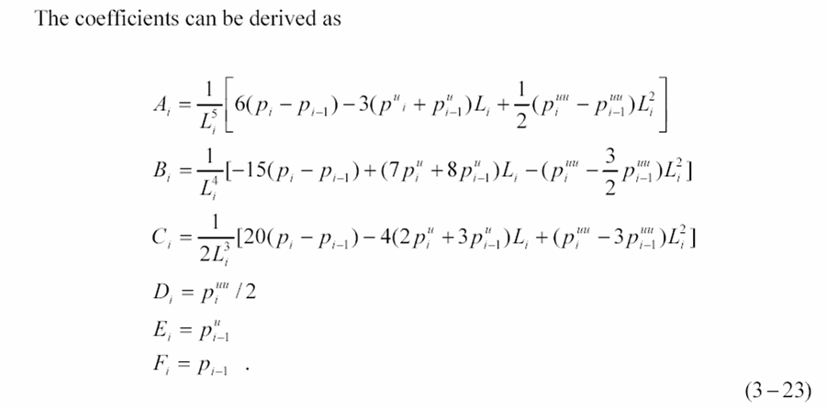
Nearly Arc-Length Parameterized Quintic Splines (NAPQS)
-1
（3.3-2）

Slide 22
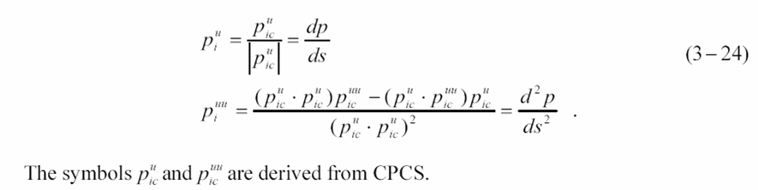
Nearly Arc-Length Parameterized Quintic Splines (NAPQS)
1. The first and second derivatives of NAPQS on the endpoints

Slide 23


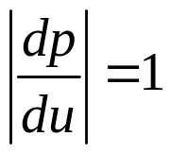
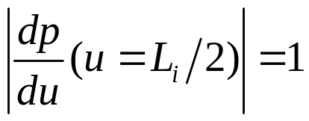
Nearly Arc-Length Parameterized Quintic Splines (NAPQS)
2. If is the arc-length , the following equation should be satisfied to all ,
So,

Slide 24
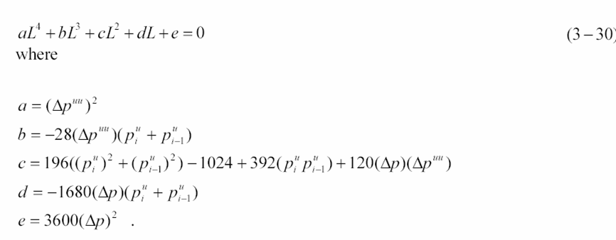
Nearly Arc-Length Parameterized Quintic Splines (NAPQS)

Slide 25

Nearly Arc-Length Parameterized Quintic Splines (NAPQS)
3. Example
Quintic Spline Curve
NAPQS

Slide 26
Interpolating Continue G01 Code with Spline Curve
1 One Critical Condition---big fluctuation of curve occurs near big line segments.
Big fluctuation of curve
Big Line Segment
a) Interpolating through big line segement
b) Big line segement terminated Interpolating
Big line sengment

Slide 27
Interpolating Continue G01 Code with Spline Curve
2 Another Critical Condition------Big fluctuation of curve occurs near sharp corner.
Big fluctuation of curve
a) Interpolating through sharp corner
b) Sharp corner terminated interpolating
Sharp Corner

Slide 28
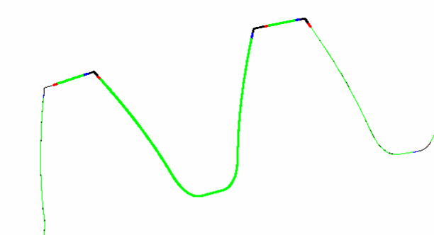
Interpolating Continue G01 Code with Spline Curve
Example:
Sharp corner
The First Segment of Piecewise Spline curve
All Middle Segments of Piecewise Spline curve
The Last Segment of Piecewise Spline curve
Interpolate Tooth profile by NAPQS

